Slide 1
Annual General meeting
Presented at the 8th biennial SAMEA Conference in sandton, and Virtually
22 September 2022

Slide 2
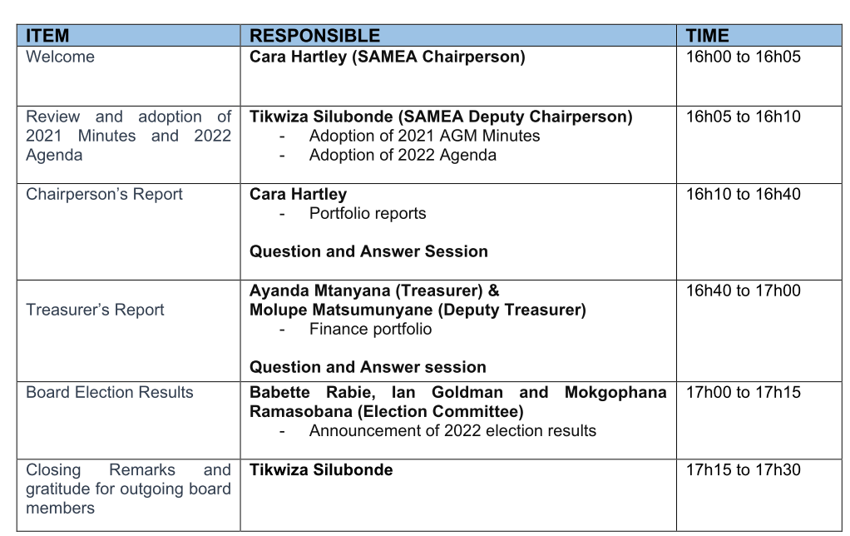
agenda

Slide 3
Review & adoption of 2021 minutes

Slide 4
review & adoption of today’s agenda

Slide 5
Chairperson & Board feedback

Slide 6
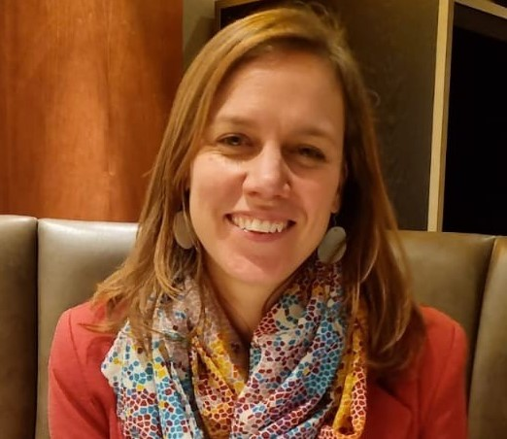
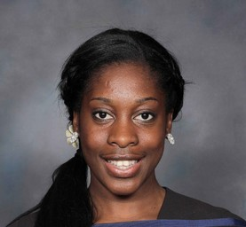
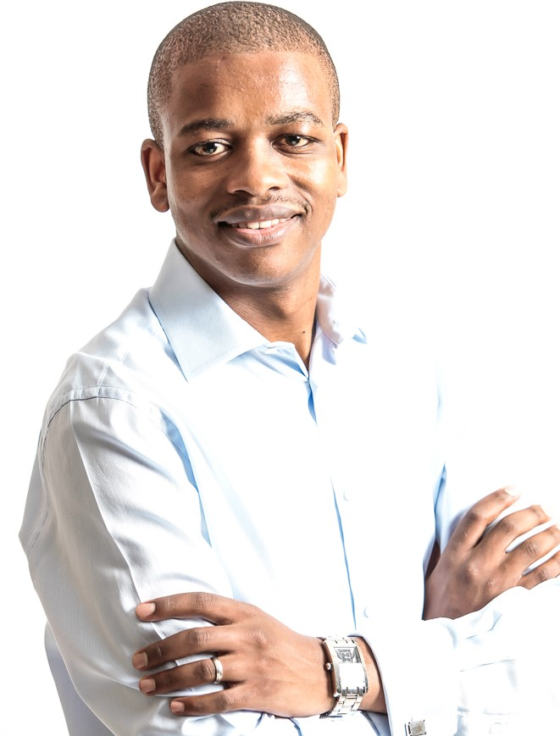
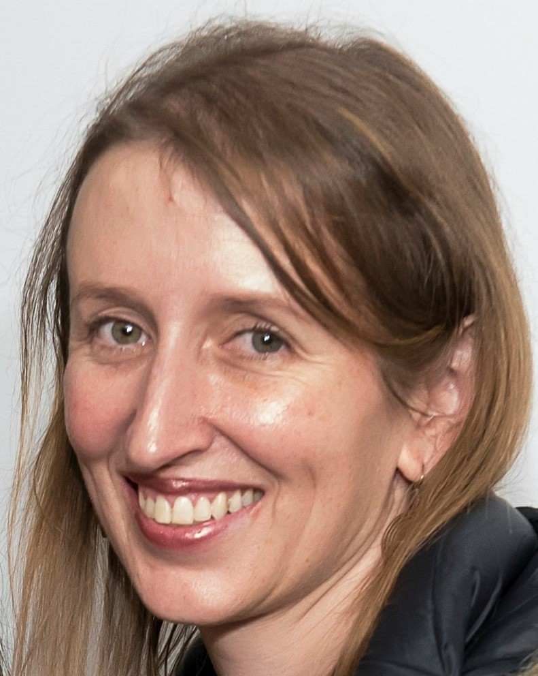
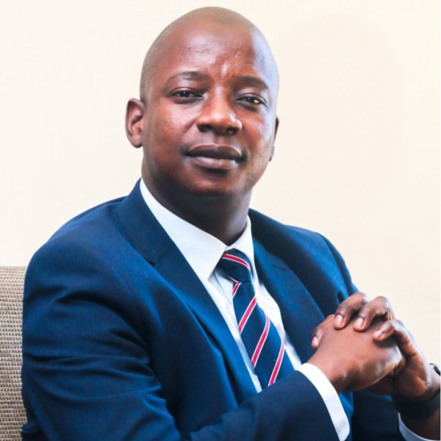
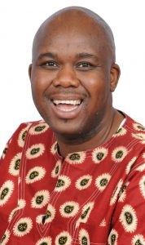
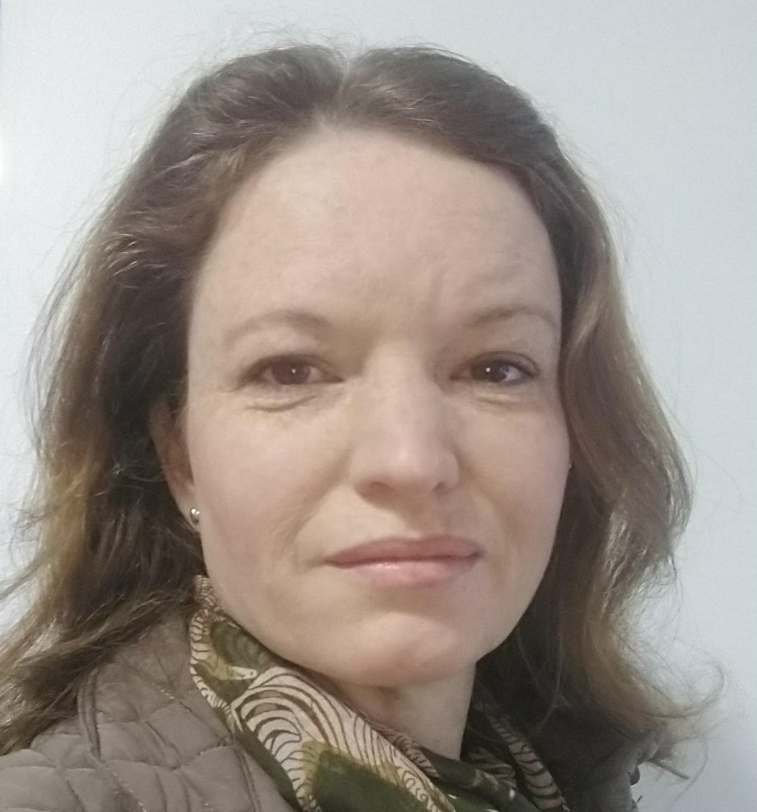
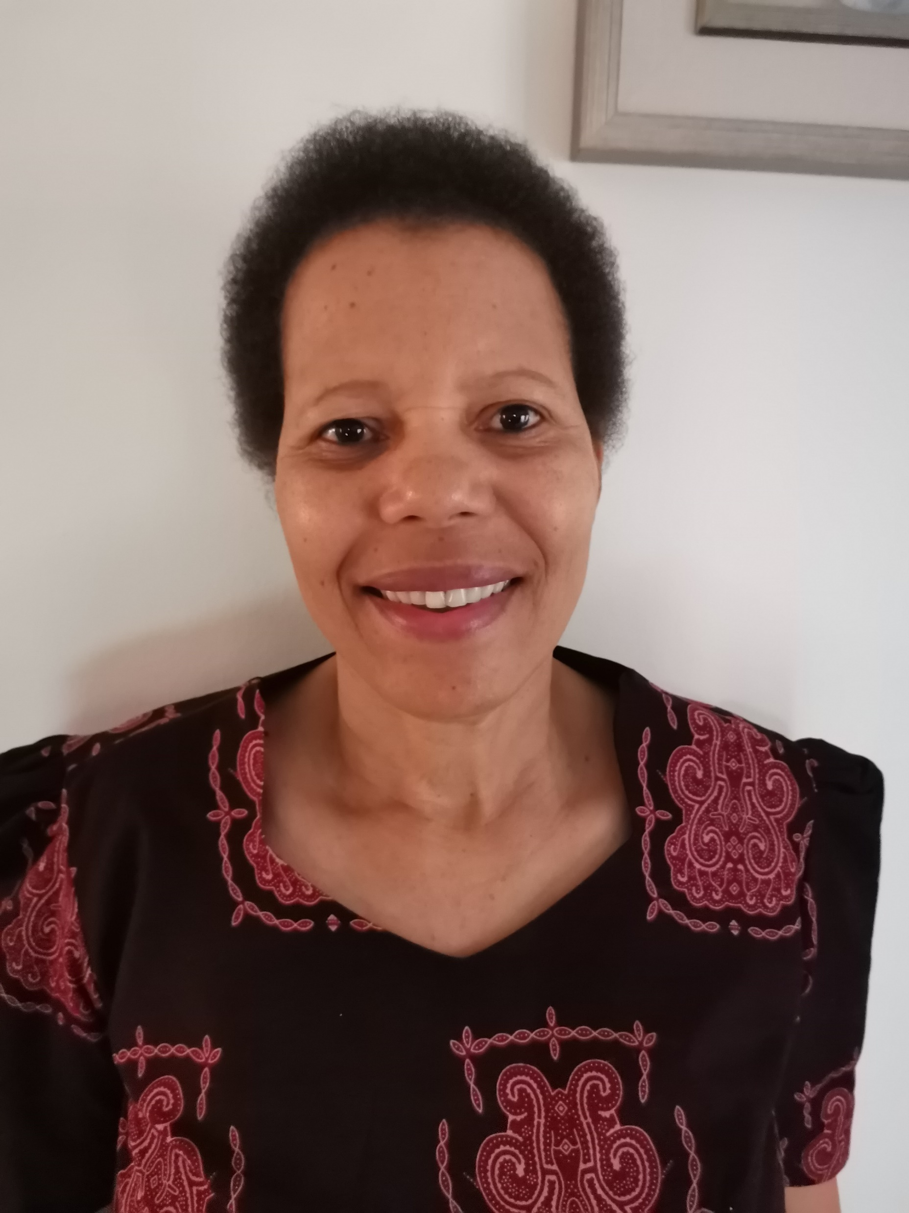
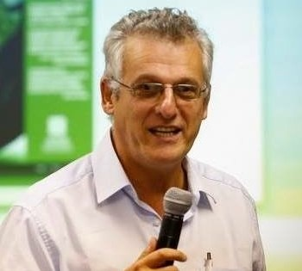
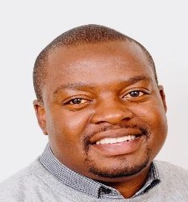
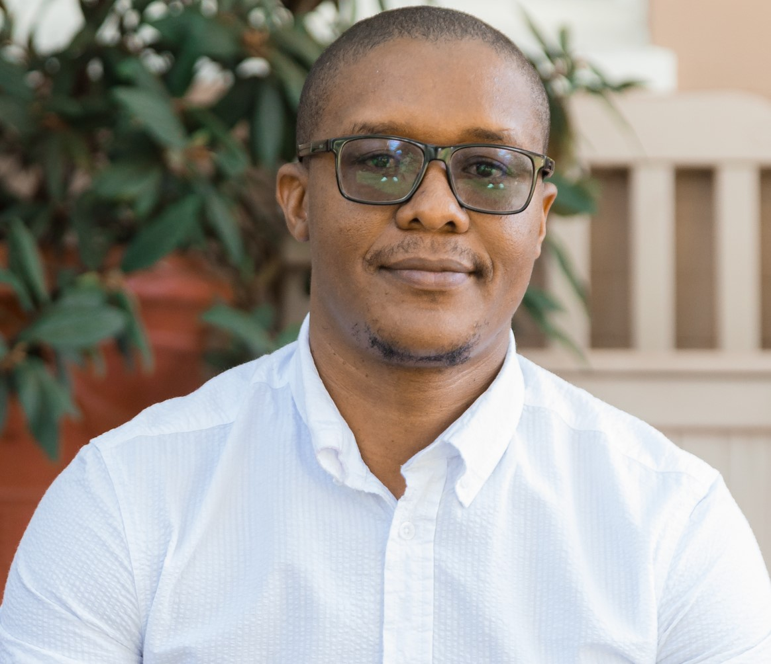
Board 2021/2022
Cara Hartley:
Chair
Tikwiza Silubonde: Deputy Chair
Ayanda Mtanyana: Treasurer
Eleanor Hazell: Operations Lead
Molupe Matsumunyane: Deputy Treasurer
Mokgophana Ramasobana
Babette Rabie
Ruth Mojalefa
Ian Goldman
Takunda Chirau
Moses Mashingaidze

Slide 7
SAMEA Secretariat 2021/2022
Our current secretariat
Gaynor Nel – SAMEA Coordinator
Marla Naidoo – SAMEA Administrator
Sivenati Yami – EE intern
Thank you!
Elnari Potgieter – former SAMEA Coordinator
Pamela Hlahla – former EE Coordinator

Slide 8
Feedback topics
Portfolio / Area of work | Board member providing feedback
Building a stronger organisation | Eleanor Hazell & Cara Hartley
Membership Services and Communications | Ruth Mojalefa
SAMEA review | Eleanor Hazell
Partnerships and Advocacy | Mokgophana Ramasobana
Co-Creation | Ian Goldman and Moses Mashingaidze
Research | Babette Rabie
Workshops | Babette Rabie
Emerging Evaluators | Takunda Chirau
Treasury | Ayanda Mtanyana (presented as a separate agenda item)

Slide 9
Building a stronger organisation governance & strategy
Only 2 priorities
Dissemination of a 2-page SAMEA Strategy
Introduction of an Operations Lead on the Executive; and Deputy Treasurer
Elections & inductions
Expansion of Board from 10 to 11 (and soon to 13)

Slide 10
Building a stronger organisation Operations Lead New EXCO portfolio established in 2022 to support SAMEA’s growth
2022 Highlights
Recruitment.
Secretariat staff – a strong team.
Strengthening operations.
Defining & documenting organisational procedures (timekeeping, leave, exit interview, probation review).
Developing a leave policy.
Looking ahead to 2023
Formalise appointment of an occasional HR advisor.
Continuing defining & documenting organisational procedures in line with priorities.
Review organisational templates.
Knowledge management.

Slide 12
SAMEA REview
Rationale & process
An external strategic review was last conducted in 2015 (by a legacy board member) and an internal review (membership survey) was conducted by the SAMEA Board in 2016/2017. The COVID-19 pandemic, has seen seismic shifts in the way that work is planned, organised and undertaken; M&E work is no exception.
Terms of Reference finalised April 2021.
Conducted by volunteers with support from the SAMEA Secretariat.
Sample
Survey (173 responses)
Membership Profile analysis
Social media analysis
Interviews (11 KIIs & 1 FGD with 15 respondents)
Legacy board members, EE candidates, VOPEs, Members/non-member
Preliminary findings (qualitative) presented at strategic planning, December 2021.
Preliminary findings (survey) informed conference planning.

Slide 14
Membership Services and Communications
Strategy for the year
Building a stronger organisation by means of:
Encouraging all members to renew their memberships
Using a collaborative leadership approach to instil confidence among members so that the SAMEA board represents their interests
Being responsive to members and trying to assist them as soon as possible
Offering diverse events so making it a worthwhile experience to our members eg follow through from the Evaluation Hackathon; EE Immersion Programme
This year was also about delivering a successful conference
By maintaining and strengthening communications with SAMEA members and stakeholders
Highlights
Widespread marketing of the conference. Conference has attracted over 450 physical and 100 virtual participants
Effective use of general communications through SAMEA’s regular channels
Reached out directly to key relevant stakeholders e.g DPME , UNICEF, members, M&E practitioners and chapters/networks

Slide 15
Membership services & communications (continued)
Stepping up our communications approach by means of:
Frequent SAMEA newsletters
Portfolio undertook a comprehensive SAMEA Review. We have valuable info we can use to improve our communications with our members
Regular website updates and the addition of new webpages e.g. Evaluation Hackathon and EE webpages
Membership statistics
As at 21 September 2022, SAMEA has 637 members. (371 individual members; 16 institutional members of which 163 are members and 103 student members). The top province is Gauteng followed by Western Cape, Eastern Cape, KZN and the other provinces.
Looking ahead
SAMEA review findings will help us to better communicate with members
Partnership with more stakeholders to further strengthen communications and commit to multi-year projects
Building on lessons learned from 2022 Conference communications and marketing for future years

Slide 16
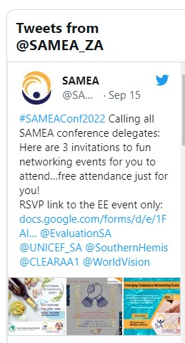
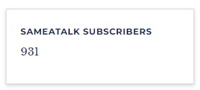
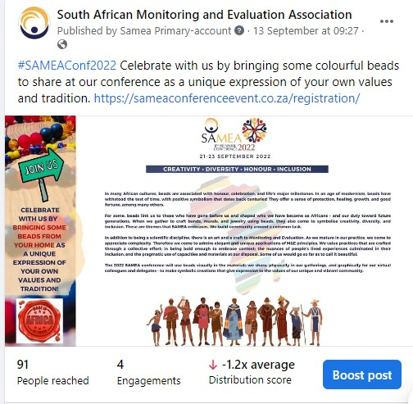
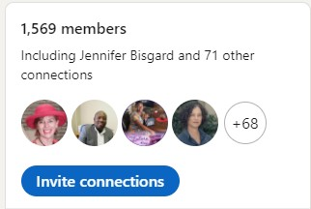
LinkedIn
Facebook

Slide 17
INSTITUTIONAL MEMBERS

Slide 18
Partnerships & advocacy
Partnerships integrated to our three-year strategic plan expressed through our TOC (formalised via MOUs/MOAs)
Steered implementation of programmes – Cocreation initiatives, EE programme, 2022 conference, Workshops
Most importantly, advocated for systematic changes such as Evidence Map in partnership with DPME, Competency framework (QA NSG curriculum etc), enabled growth of our Secretariat
Lessons & priorities – a dedicated board member, takes time, must be reviewed at different intervals, explore engaging with other spheres of government (SOEs, Local government, Legislative sector etc)

Slide 19
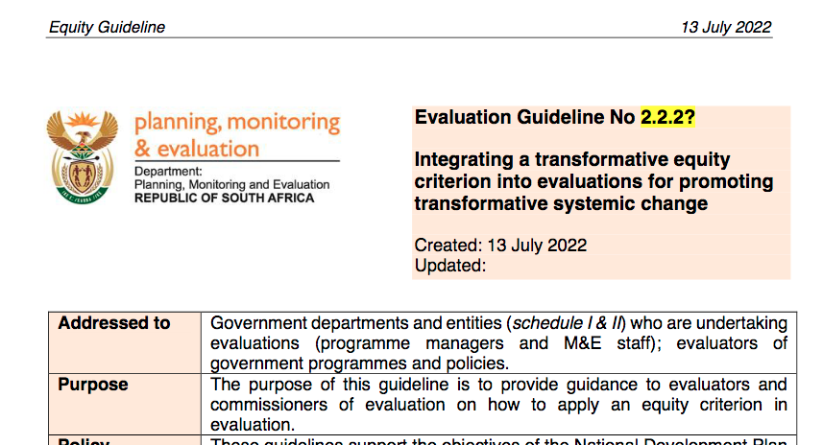
Co-creation
Importance of co-creation to address the complex problems facing the country and planet
Focus on hackathon as first project
9 teams focusing on Using M&E to address Systemic Crises; Undertaking M&E in crisis; MAE; evidence map building on existing evaluations – first three core themes for the Conference
Virtual hackathon - 8-22 October 2022 - Five hackathon partners, 150 hackathoners involved including 32 EEs, top speakers eg Michael Quinn Patton, Presidential Climate Commission
Systemic crises – 2 guidelines have been produced on climate/ecosystem health & equity, peer reviewed, piloted with UIF, DSD, DSI – will hear report back at conference
M&E in crisis – guideline on virtual evaluation, 3 rapid evaluation plans, being implemented by EEs with evaluation facilitator and first evaluation now complete
MAE – initial work on conceptualising – built on for conference
Conference deciding where we take the co-creation next year

Slide 20
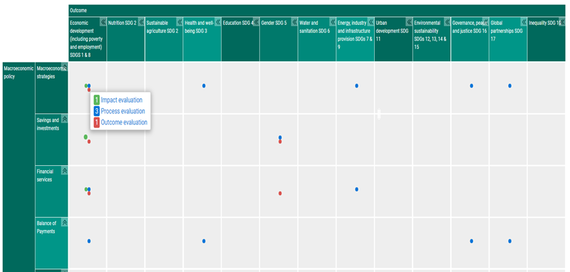
Research
A Hackathon team, comprising a significant portion of DPME officials, developed draft criteria and alternative action plans for a South African Evaluations Evidence Map.
DPME is moving forward with the development of the evidence map, driven jointly by the DPME Evaluations, and Research and knowledge management directorates. SAMEA members form part of the reference group for this exciting initiative
DPME has engaged with government departments to share completed evaluations. Through SAMEA talk, evaluation consultants, researchers, practitioners will be invited to identify and/or submit completed evaluation studies for inclusion in the evidence map
Evidence maps show where evidence is available, and help to identify evidence gaps. Raise awareness, interest and potential use of available studies, and identify priorities to address information gaps
Important role of SAMEA to leverage partnerships and networks to strengthen the M&E landscape in South Africa.

Slide 21
CAPACITY BUILDING workshops
Three SAMEA workshops were offered in June
Orientation to Research for Evaluation – a SAMEA, custom designed programme, to provide an orientation for those new to evaluation research
Virtual Evaluation – training on the virtual evaluation guideline as developed during/post the 2021 Hackathon, to equip participants with practical methodologies for collecting and presenting evaluation data
Climate/ecosystems and Equity Guidelines – guidance to the commissioners of evaluation to apply these two additional criteria to evaluations, another product of the 2021 Hackathon, 3 pilot evaluations participated from DSD, DSI, DPME and UIF
Total number of delegates: over 60 in attendance
Small budget for external support, mostly organized by the SAMEA secretariat
Potential opportunity for additional income stream for SAMEA, and more regular capacity building opportunities for members

Slide 22
Emerging evaluators (EE)
Pilot EE Programme launched by SAMEA in partnership with

Slide 23
Emerging evaluators (EE)
Six host organisations participated in the programme, namely;

Slide 24
Emerging evaluators (EE)
As part of the capacitation component of the programme each EE was partnered with a mentor.
Positive feedback received from the EE’s and host organisations.
Phase 2 of the EE Programme will be implemented in the new fiscus.

Slide 26
Treasurer’s report
Ayanda Mtanyana
Treasurer

Slide 27
Financial review for year ending 28 February 2022
SAMEA had a healthy bank balance of R2.7m in FY2022, which is significantly higher than usual for a non-conference year due to grant income for co-creation and EE programmes
The virtual format of the Capability Building workshops remained cost-effective, which enabled SAMEA to survive delaying the 8th Conference until this year
It is critical to fundraise for the EE programme for continuity and to improve our membership and sponsorships fees
Treasury Management Guidelines continue to be followed with the exception of a finance sub-committee (decisions are made a board level)
BVSA continued to serve as the SAMEA bookkeepers and prepares the financial statements for audit purposes
BVA Inc. are the SAMEA auditors, which is part of the same group of companies as BVSA, but not the same company

Slide 28
Financial review for year ending 28 February 2022
SAMEA continued to have a healthy bank balance. FY2022 saw us maintain an above target amount and diversify sources of funding. This allowed the Association to pursue strategic imperatives such as EE capacity building and responsive co-creation efforts that contribute to knowledge and practice.

Slide 29
Financial review for year ending 28 February 2022
SAMEA had retained income that could give it a two-year runway, assuming that the conference at least breaks even. This is even so at the increased secretariat capacity of 0.5FTE Coordinator and 0.8FTE Administrator, which is critical to deliver services and for board sustainability.

Slide 30
Financial review for year ending 28 February 2022
We have consistently done well with collections of conference and workshop proceeds by the end of the subsequent financial year.

Slide 31
Financial review for year ending 28 February 2022
Our membership fees improved despite it being a non-conference year. Similarly, we were also able to secure adequate sponsorships to break even for the capability building workshops. In addition to the virtual format, this has enabled SAMEA to limit subsidizing the workshops from retained income.
Workshop
Workshop
Workshop

Slide 32
Looking ahead…
This conference will contribute towards the objectives of SAMEA and its sustainability
Our new initiatives such as the co-creation and the EE internships deliver value to our members and we should to fundraise to ensure continuity
We should continue to strengthen our value proposition to our members and sponsors to grow our base

Slide 33
Review of FY2022 AFS Approval of Audited Financial Statement

Slide 34
2022 Election results
2022 Elections Committee: Babette Rabie, Ian Goldman, Mokgophana Ramasobana
The 2022 elections results are as follows:
Number of votes cast: 289 (if you consider a vote on more than one nominee as multiple votes) Number of voters: 109 Number of nominations: 22 Number members nominated: 18 Number of nominations accepted: 17 Number of nominations confirmed: 9
The SAMEA elections were conducted online and was managed by an external IT management company, Development IT Solutions
Only members with an active paid up membership could participate in the elections
Nominations took place from 1 July 2022 – 25 August 2022
Formal Voting Process took place from 12 September – 21 September 2022

Slide 35
2022 – 2023 SAMEA board members
The new SAMEA board members are:
Asgar Bhikoo
Jennifer Norins
Mayibongwe Mncube
Mishkah Teladia
Nana Davies

Slide 36
Closing remarks

Slide 37
end

