Slide 1
Transformative Equity: A Necessary Evaluation Criterion for Transforming Society Through Evaluation
European Evaluation Society
14th Biennial Conference June 2022
J. Norins, S. Tsekiso,
Z. Brey, T. Lukuko, I. Goldman

Slide 2
Presentation outline
Background:
SAMEA Hackathon and development process
Why an evaluation criterion on equity?
South African context and where the guidelines fit
Criterion components
Definition
Dimensions
Principles
Integrating equity criterion into evaluation TORs and commissioned process
Process
Evaluation questions
Current status and next steps

Slide 3
Reflective questions
Q: How do you currently ensure equity in your evaluation practice?
Q: How do you currently assess the extent to which interventions promote equity in transformational ways?
Q: How could a criterion on equity support your evaluation practice?

Slide 4
Development Process
SAMEA Evaluation Hackathon October 2021
One of two groups focused on evaluation criteria for Anthropocene times
Challenge: What would an evaluation criterion on equity look like?
Two weeks developing rough criterion and complementary guidelines
18 participants; representatives from national and provincial government, CSOs
November to current – refinement, peer review and revision, preparing for piloting July/August 2022
Issuing by South African Department of Planning, Monitoring and Evaluation (DPME)
Reflect on application at SAMEA conference in September 2022

Slide 5
Why a criterion on transformative equity?
Assumption that evaluation plays critical role in transforming systems
Evaluation “straddles both theory and practice,” enabling it to support transformational learning and change (Chaplowe, 2021).
MQP: evaluation needs to contribute to discourse in social transformation
Criteria are key guideposts for conducting evaluations
DAC criteria suggests equity can be integrated into existing criteria (GAP!)
How can we consistently assess for equity if no criterion?

Slide 6
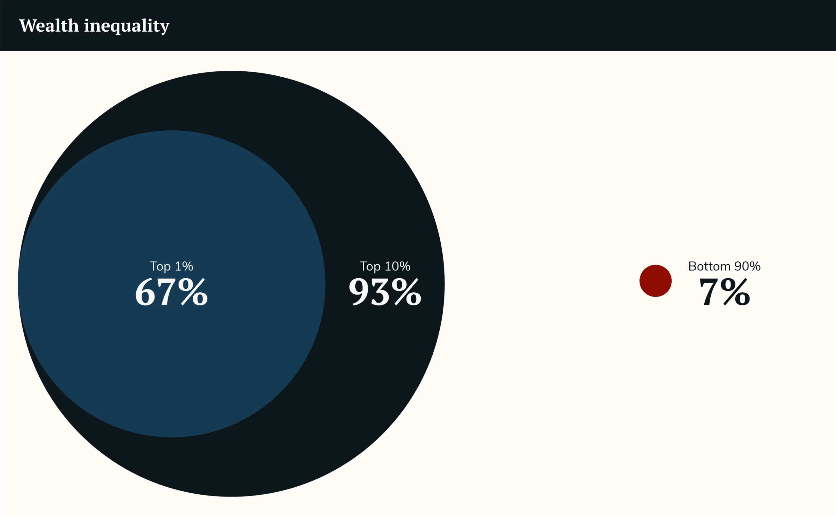
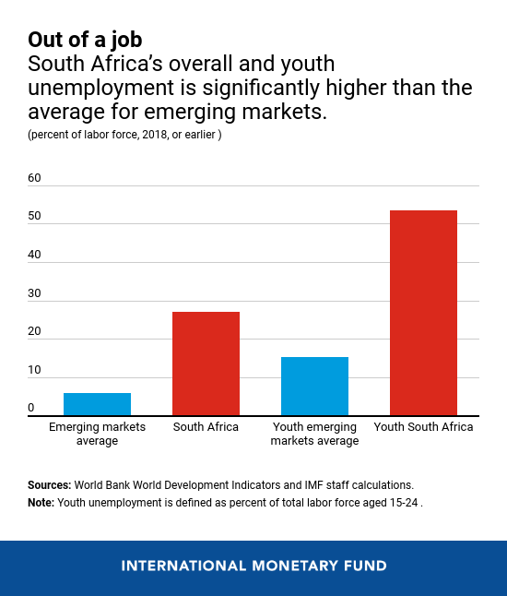
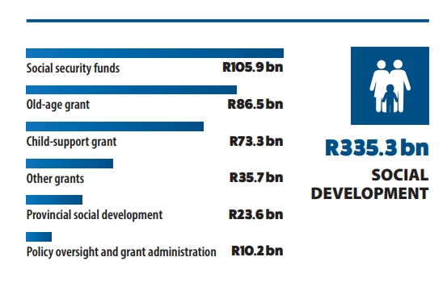
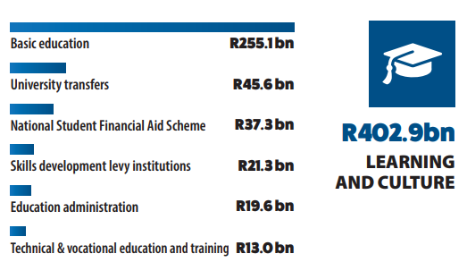
Levels of inequality in South Africa
Anna Orthofer (2016)

Slide 7
South African Context
Disproportionate allocation of resources, opportunities and other critical essentials for a quality standard of living
Low growth, declining investor interest and increased instability of markets impacting on efforts to reduce issues of poverty and inequality
Recent evaluation of the national evaluation system highlighted gaps in equity focus
South African Constitution: everyone has the right to equal protection and benefit of the law; full and equal enjoyment of all rights and freedoms
Notes:
The National Evaluation Policy Framework 2019-2024 (NEPF) presents the government’s commitment to evaluation as a mechanism for achieving the transformational national development agenda put forth in the NDP. The NEPF makes clear reference to how planning, budgeting, implementation, monitoring and evaluation of government interventions should adopt an inclusive approach, particularly for women, youth and persons with disabilities, as part of its transformative effort (DPME, 2019). However, a recent evaluation of the national evaluation system highlighted that many evaluations struggled to adequately incorporate an equity focus, and did not adequately address issues affecting women, youth, persons with disabilities, and other marginalised groups (Goldman, et. al, 2019). While the NEPF provides some guidance for where and how issues of equity should be considered within the life-cycle of an intervention, a detailed guideline on equity in evaluation provides further support to the framework in this regard.

Slide 8
South African Evaluation System Response
Recent evaluation of the national evaluation system highlighted gaps in equity focus
The NEPF 2019-2024:
Government’s commitment to evaluation as a mechanism for achieving the transformational national development agenda put forth in the NDP
Inclusive approach to planning, monitoring, implementation and evaluation of government intervention
Applicable across all three spheres of government and entities
Evaluations promoted in Government Planning Frameworks
Notes:
The National Evaluation Policy Framework 2019-2024 (NEPF) presents the government’s commitment to evaluation as a mechanism for achieving the transformational national development agenda put forth in the NDP. The NEPF makes clear reference to how planning, budgeting, implementation, monitoring and evaluation of government interventions should adopt an inclusive approach, particularly for women, youth and persons with disabilities, as part of its transformative effort (DPME, 2019). However, a recent evaluation of the national evaluation system highlighted that many evaluations struggled to adequately incorporate an equity focus, and did not adequately address issues affecting women, youth, persons with disabilities, and other marginalised groups (Goldman, et. al, 2019). While the NEPF provides some guidance for where and how issues of equity should be considered within the life-cycle of an intervention, a detailed guideline on equity in evaluation provides further support to the framework in this regard.

Slide 9
The Transformative Equity Criterion
Criterion | Transformative equity
Definition | The extent to which an intervention's objectives, design, implementation and impact contribute to, or do not contribute to, addressing systemic inequities and promote a more inclusive society
Notes | By including “transformative,” the criterion underscores the assumption that reaching equity requires a transformation of systems and structures, both of the evaluand and of the evaluation approach. Systemic inequities refer to the ways systems have been designed, established and maintained that perpetuate inequities. In South Africa, the persistent social inequities are remnants of the system of apartheid, and levels of inequality, as measured under the economic dimension by the GINI coefficient, are now the highest documented in the world . Transformative equity considers five dimensions: (1) Population/ populace: Who benefits/who loses, Who is included/who is excluded; (2) Cause and effect: How does inequity play out and How is the intervention responding to inequality; (3) Spatial: Where do key inequities persist and what are the geographical and spatial factors affecting equity; (4) Content and intention: What is the transformative change potential of the intervention ? To what extent are interventions designed to contribute to the progressive change for a more equitable South Africa; and (5) Temporal: How has the equity issue changed over time?

Slide 10
Equity Criterion Dimensions
Dimension 1 | Population/ populace: Who benefits/who loses, Who is included/who is excluded
Dimension 2 | Cause and effect: How does inequity play out and How is the intervention responding to inequality
Dimension 3 | Spatial: Where do key inequities persist and what are the geographical and spatial factors affecting equity
Dimension 4 | Content and intention: What is the transformative change potential of the intervention? To what extent are interventions designed to contribute to the progressive change for a more equitable South Africa
Dimension 5 | Temporal: When is the intervention/evaluation taking place? How has the equity issue changed over time?

Slide 11
Equity Principles
Equality, justice + respect for human dignity | How does the intervention or the evaluation process itself promote equality and human dignity? Does intervention and evaluation promote justice?
Awareness of power and voice | Evaluators, commissioners, and funders must be prepared to explicitly search for how power manifests in the intervention and influences the evaluation process.
Ubuntu | Evaluators and commissioners of evaluation are urged to consider the multiple and interconnected ways of knowing and ways of being that will influence how an intervention is experienced and how values are determined and to ensure that benefits accrue equitably
Inclusivity | Inclusivity reflects the intentional inclusion of the multiple identities and geographies that are affected (directly or indirectly) by a given intervention and ensure adequate representation of these identities and geographies in different phases of the evaluation including preparation, implementation, and follow-up
Systems thinking | Evaluation practice needs to incorporate analyses of interactions and inclusivity within systems. This can be achieved by mapping and understanding the components of sub-systems of interest and understanding their needed contributions within the overall system

Slide 12
Integrating Transformative Equity into TOR
Stakeholder engagement: intentional, inclusive, aware of power dynamics; throughout entire evaluation process
Scope and purpose: define equity issues under consideration
Evaluation questions: modify questions to include consideration of the equity dimensions
Evaluation design: consider system dynamics and power relations, clear guidance for participatory approaches, desired sample and methodologies

Slide 13
Example of Transformative Equity questions
Formative/ implementation evaluation | Is the intervention being implemented as specified, are the outcomes likely to be achieved and why, and is the intervention likely to result in changes in the equity dimensions? | What has been the level of participation/collaboration between key stakeholders in the implementation of the programme? To what extent has the participation or collaboration between stakeholders demonstrated objectives of transformative equity/principles of inclusion, representativeness, and respect? (what) (effectiveness) What factors influence the way the programmes are implemented (how)? What power dynamics are at play (how)? (effectiveness) How is the context/situation changing for beneficiaries/stakeholders over the period of the implementation? What influence does shift in context/policy/discourse have on the intervention’s likely success? (when)

Slide 14
DPME’s considerations for use
DPME will ensure inclusion of transformative equity in the:
National Evaluation Policy Framework
Generic criteria for prioritising evaluations
Capacity development courses, tools and strategy
Different types of evaluations
DPME to support the adoption of and training on the “Integrating a transformative equity criterion in evaluations for promoting transformative systematic change” guideline
DPME to ensure all evaluation documents meet the equity criteria in addition to the DAC criteria
Notes:
The National Evaluation Policy Framework 2019-2024 (NEPF) presents the government’s commitment to evaluation as a mechanism for achieving the transformational national development agenda put forth in the NDP. The NEPF makes clear reference to how planning, budgeting, implementation, monitoring and evaluation of government interventions should adopt an inclusive approach, particularly for women, youth and persons with disabilities, as part of its transformative effort (DPME, 2019). However, a recent evaluation of the national evaluation system highlighted that many evaluations struggled to adequately incorporate an equity focus, and did not adequately address issues affecting women, youth, persons with disabilities, and other marginalised groups (Goldman, et. al, 2019). While the NEPF provides some guidance for where and how issues of equity should be considered within the life-cycle of an intervention, a detailed guideline on equity in evaluation provides further support to the framework in this regard.

Slide 15
Current Status and Next Steps
Draft guidelines shared with reviewers in April 2022
Comments received
Key issues raised
Need for tools and resources for evaluators
Need for more focus on justice and transformation
Need for more alignment with guideline on climate and ecosystem health
Preparing for training and piloting in July 2022
Just Transition COP planning a conference strand for SAMEA hybrid conference in September 2022 - guidelines and piloting will be highlighted (do join us!)

Slide 16
Please get in touch!
Jennifer Norins – jennorins@gmail.com
Sinenhlanhla Tsekiso – sinenhlanhla@dpme.gov.za
Zulaikha Brey – Zulaikha.brey@dnaeconomics.com
Thando Lukuko – coordinator@sacan.africa
Ian Goldman – ian.goldman@wits.ac.za

